Slide 1
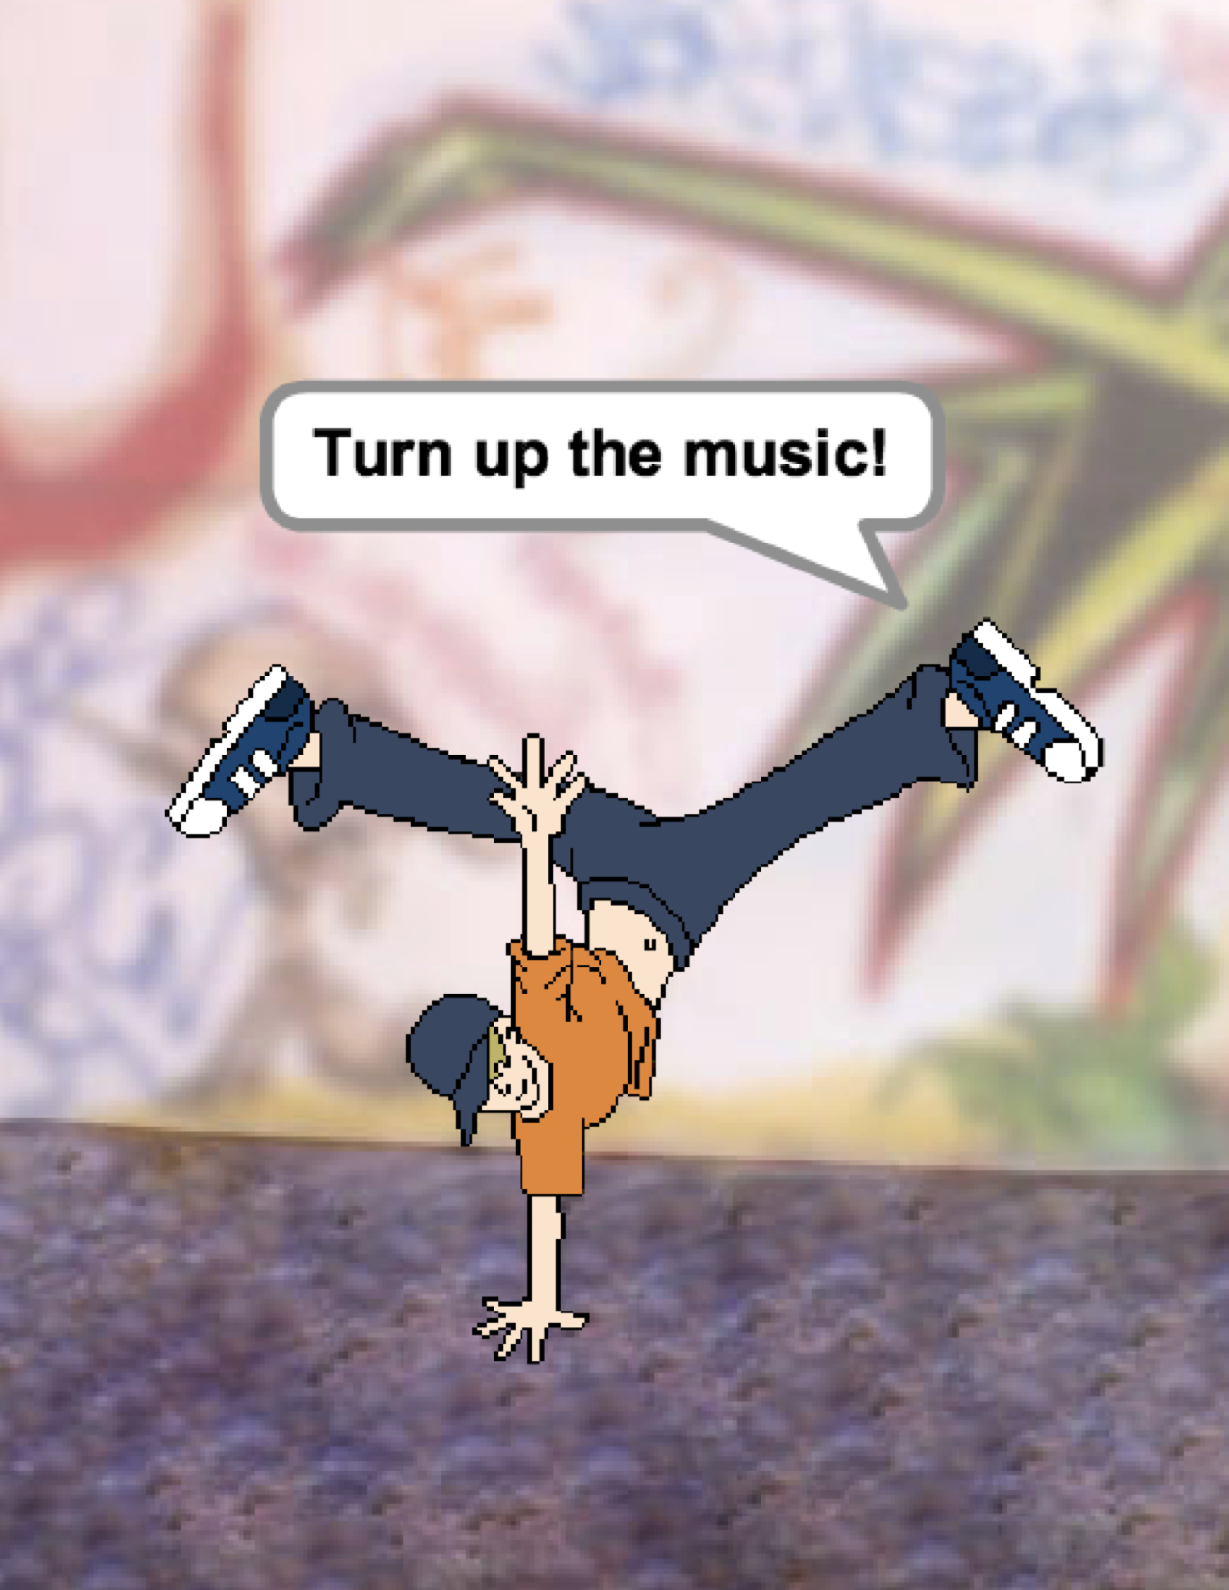
UNIT 2
ANIMATIONS
WHAT’S INCLUDED
YOU ARE HERE
PERFORMING SCRIPTS 42
BUILD-A-BAND 44
ORANGE SQUARE, PURPLE CIRCLE 46
IT’S ALIVE! 48
DEBUG IT! 50
MUSIC VIDEO 52
0
1
2
3
4
5
6
39
Notes:
<numéro>

Slide 2
UNIT 2
OVERVIEW
THE “BIG IDEA”
Kids have shared more than six million projects in the Scratch online community – animations, stories, games, and beyond – and one of our goals with the guide is to reflect this enormous diversity of creations. Within activities, we support opportunities to personalize and avoid presenting challenges that have only one “right” answer; across activities, we engage learners in a variety of genres. In this unit, we start to explore this creative diversity with a deep dive into animation, art, and music.
Creative diversity in Scratch has often been highlighted by learners. Here are a few quotes from learners who were asked, “If you had to explain what Scratch is to one of your friends, how would you describe it?”
It’s a program that lets you explore your imagination. You can do whatever you want in it. You can create anything. There really is no limit to what you can make. You design your own stuff, and once you start you just don’t want to stop because as you learn more, you can see there’s more possibilities, and the more possibilities there are, the more you want to expand on what you just learned.
Bradley, 12 years old
Well, I like that you can sort of do anything on it. It’s like you can do whatever you want, really. You can be as creative as you want to be.
Aaron, 10 years old
It’s just that there’s endless possibilities. It’s not like you can just make this project or this project and that’s all that you can make.
Nevin, 9 years old
It’s really great to express yourself creatively. You could do anything with it. You can make video games, music, art, videos, anything. The possibilities are endless, no limitations, really.
Lindsey, 12 years old
Students will:
be introduced to the computational thinking concepts of loops, events, and parallelism
become more familiar with the concepts of sequence
experiment with new blocks in the Events, Control, Sound, and Looks categories
explore various arts-themed Scratch programs
create an animated music video project
KEY WORDS, CONCEPTS, & PRACTICES
LEARNING OBJECTIVES
loops
events
parallelism
control
broadcast
scripts
presentation mode
bitmap
vector
animation
gallery walk
NOTES
Many activities in this unit include elements of sound and music. We recommend having headphones readily available for students.
40
Notes:
<numéro>

Slide 3
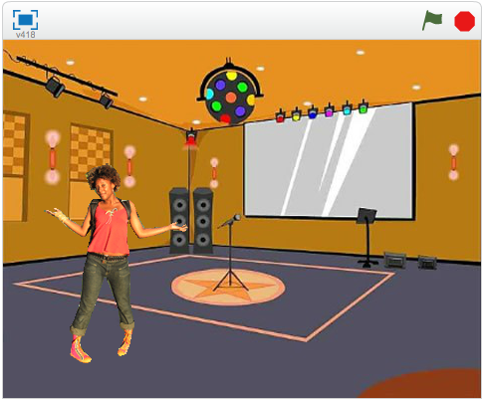
CHOOSE YOUR OWN ADVENTURE
Programming in Scratch is like directing theatre. In theatre, just as in Scratch, there are characters (sprites, in Scratch parlance), costumes, backdrops, scripts, and a stage. Scratch programming utilizes cues called “events”, which signal when things should occur in a project, such as: activating a project (when green flag clicked), triggering sprites’ actions (when this sprite clicked), or even sending a silent cue across sprites or backdrops (broadcast).
Inspired by the theatre metaphor, this unit’s arts-themed activities are designed to help students explore the computational concepts of loops, events, and parallelism, culminating in the design of personalized music videos.
POSSIBLE PATH
SESSION 1
SESSION 2
SESSION 3
SESSION 4
SESSION 4 & SESSION 5
PERFORMING SCRIPTS
BUILD-A-BAND
ORANGE SQUARE,
PURPLE
CIRCLE
IT’S ALIVE!
DEBUG IT!
MUSIC VIDEO
Play the part of a sprite by acting out different Scratch blocks and scripts.
Create your own musical group by making interactive instruments.
What project can you create that includes an orange square and a purple circle?
Can you
animate it? Experiment with multiple costumes to bring an image to life.
Help!
Can you debug these five Scratch programs?
How can you combine animation with music to create your own
Scratch-inspired music video?
41

Slide 4


PERFORMING SCRIPTS
OBJECTIVES
By completing this activity, students will:
be introduced to the concepts of events (one thing causing another thing to happen) and parallelism (things happening at the same time) through performance
be able to explain what events are and how they work in Scratch
be able to explain what parallelism is and how it works in Scratch
UNIT 2 ACTIVITY
_{SUGGESTED TIME}
30–45 MINUTES
ACTIVITY DESCRIPTION
RESOURCES
Optionally, have a projector connected to a computer with Scratch open to display which blocks and scripts will be performed.
Ask for two volunteers.
Prompt the two volunteers to act out a series of instructions (either by “programming” the volunteers through the Scratch interface or through printed-out physical versions of the Scratch blocks).
- Have one person do one thing (like walk across the room).
- Have that person “reset”.
- Have that person do two things simultaneously (like walk across the room and talk).
- Add the second person, by having the second person simultaneously (but independently) do a task, like talking.
- Have the second person do a dependent task, like responding to the first person instead of talking over.
Reflect on the experience as a group to discuss the concepts of events and parallelism using the reflection prompts to the right.
projector (optional)
physical Scratch blocks (optional)
REFLECTION PROMPTS
What are the different ways that actions were triggered?
What are the mechanisms for events in Scratch?
What were the different ways in which things were happening at the same time?
What are the mechanisms that enable parallelism in Scratch?
REVIEWING STUDENT WORK
Can students explain what events and parallelism are and how they work in Scratch?
NOTES
NOTES TO SELF
This activity highlights the notion of “reset”, which is something Scratchers often struggle with as they get started. If they want things to start in a particular location, with a particular look, etc., students need to understand that they are completely responsible for programming those setup steps.
This activity can be useful for demonstrating the broadcast and when I receive block pair.
42
Notes:
<numéro>

Slide 5
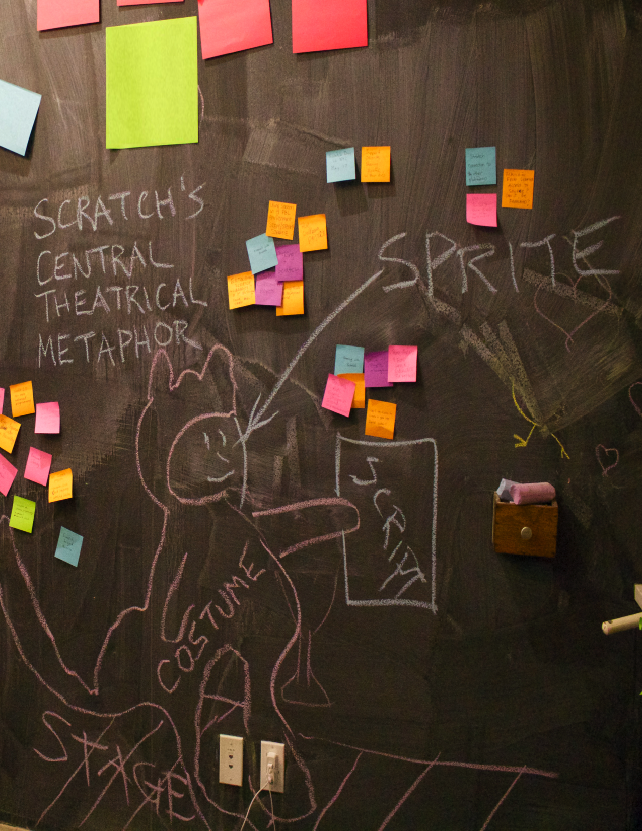
Notes:
<numéro>

Slide 6
BUILD-A-BAND
OBJECTIVES
By completing this activity, students will:
create a program that combines interactive sprites with interesting sounds
develop greater fluency with sequence, loops, events, and parallelism
practice experimenting and iterating in building up project creations
UNIT 2 ACTIVITY
_{SUGGESTED TIME}
30–45 MINUTES
ACTIVITY DESCRIPTION
RESOURCES
Optionally, show example projects from the Build-a-Band studio and have the Build-a-Band handout available to guide students.
Give students time to create interactive instruments by pairing sprites with sounds. Encourage them to experiment with different ways to express sounds in Scratch by exploring other blocks in the Sounds category or using the editing tools within the Sounds tab.
Allow students to demonstrate their bands to one another or let students walk around to interact with classmates’ instruments. We recommend a gallery walk: have students put their projects in presentation mode and then invite them to walk around and explore each other’s projects. Optionally, have students add their projects to the Build-a-Band studio or a class studio.
Ask students to think back on the design process by responding to the reflection prompts in their design journals or in a group discussion.
Build-a-Band handout
Build-a-Band studio
http://scratch.mit.edu/studios/475523
REFLECTION PROMPTS
What did you do first?
What did you do next?
What did you do last?
REVIEWING STUDENT WORK
Do projects make creative use of sounds?
Are the sprites in the projects interactive?
NOTES
NOTES TO SELF
To share as a whole group, have students perform their Scratch instruments together to form a class band!
44
Notes:
<numéro>

Slide 7
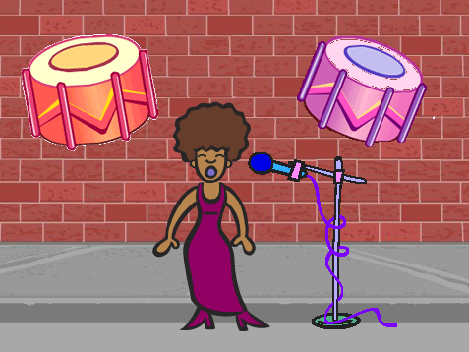



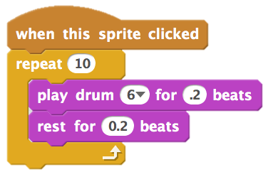
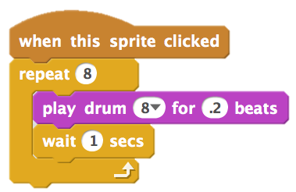
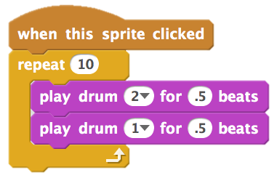
BUILD-A-BAND
HOW CAN YOU UTILIZE SCRATCH TO CREATE SOUNDS, INSTRUMENTS, BANDS, OR STYLES OF MUSIC THAT REPRESENT THE MUSIC YOU LOVE MOST?
In this activity, you will build your own music-inspired Scratch project by pairing sprites with sounds to design interactive instruments.
START HERE
Create a sprite.
Add sound blocks.
Experiment with ways to make your instruments interactive.
Choose instruments from the sprite library or create your own.
THINGS TO TRY
FINISHED?
Use repeat blocks to make a sound play more than once.
Import or record your own sounds or experiment with the Sounds editor.
Try playing with the tempo blocks to speed up or slow down the rhythm.
Add your project to the Build-A-Band Studio: http://scratch.mit.edu/studios/475523
Challenge yourself to do more! Invent a new instrument or record your own sounds.
Help a neighbor!
Notes:
<numéro>

Slide 8
ORANGE SQUARE,
PURPLE CIRCLE
OBJECTIVES
By completing this activity, students will:
express their creativity by completing an arts-themed challenge
gain more fluency with Looks blocks and the paint editor
UNIT 2 ACTIVITY
_{SUGGESTED TIME}
30–45 MINUTES
ACTIVITY DESCRIPTION
RESOURCES
Optionally, show example projects from the Orange Square, Purple Circle studio and have the Orange Square, Purple Circle handout available to guide students.
Give students time to create a project that includes an orange square and a purple circle. Invite students to experiment with Looks blocks and the paint editor to explore their artistic abilities.
Encourage students to share their creative work with others. We recommend gallery walk: have students put their projects in presentation mode and then invite them to walk around and explore each other’s projects. Optionally, have students add their projects to the Orange Square, Purple Circle studio or a class studio.
Ask students to think back on the design process by responding to the reflection prompts in their design journals or in a group discussion.
Orange Square, Purple Circle handout
Orange Square, Purple Circle studio
http://scratch.mit.edu/studios/475527
REFLECTION PROMPTS
How did you incorporate an orange square and a purple circle into your project? Where did this idea come from?
What was challenging about this activity?
What was surprising about this activity?
REVIEWING STUDENT WORK
Do projects include an orange square and a purple circle?
NOTES
NOTES TO SELF
If students have questions, remind them that they can open the Tips Window to learn more about specific blocks or different parts of the Scratch editor.
Scratch supports both bitmap and vector graphics. Help students navigate to the vector mode or bitmap mode button in the paint editor to design and manipulate different types of images and text.
46
Notes:
<numéro>

Slide 9

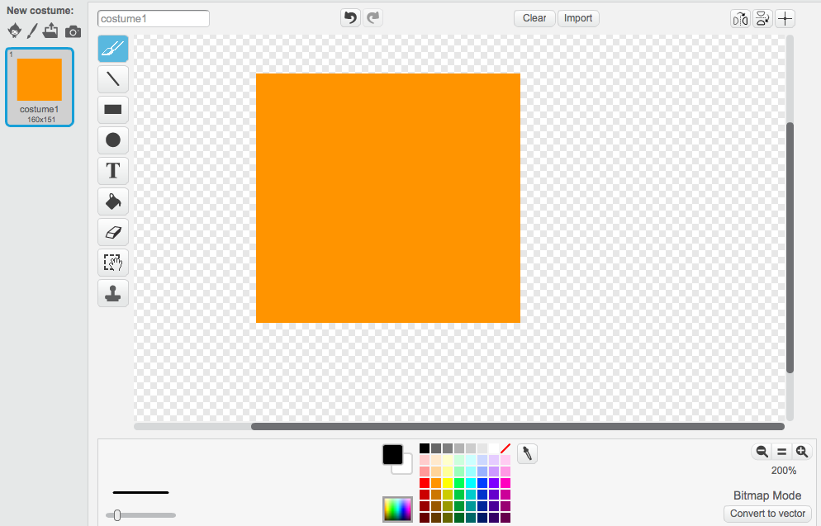
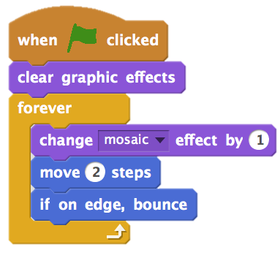
ORANGE SQUARE,
PURPLE CIRCLE
WHAT PROJECT CAN YOU CREATE THAT INCLUDES AN ORANGE SQUARE AND A PURPLE CIRCLE?
In this challenge, you’ll create a project that includes an orange square and a purple circle. What will you create?
START HERE
Draw your sprites using the Paint Editor.
Add different Looks and Motion blocks to bring your sprites to life.
Repeat!
FEELING STUCK?
_{THAT’S OKAY! TRY THESE THINGS…}
FINISHED?
Try brainstorming with a neighbor!
Create a list of things you would like to try before you start building your project in Scratch!
Explore other projects to see what others are doing in Scratch – this can be a great way to find inspiration!
Add your project to the Orange Square, Purple Circle Studio:
http://scratch.mit.edu/studios/475527
Explore the difference between bitmap mode and vector mode, located at the bottom of the paint editor.
Challenge yourself to do more! Add another shape and color.
Swap projects with a partner and remix each other’s creations.
Help a neighbor!
Notes:
<numéro>

Slide 10
IT’S ALIVE!
OBJECTIVES
By completing this activity, students will:
become more familiar with the computational concepts of sequence and loops by experimenting with Control blocks
be able to explain the difference between sprites and costumes
practice experimenting and iterating through developing an animation project
UNIT 2 ACTIVITY
_{SUGGESTED TIME}
30–45 MINUTES
ACTIVITY DESCRIPTION
RESOURCES
Optionally, show example projects from the It’s Alive! studio and have the It’s Alive! handout available to guide students.
Introduce the concept of an animation as looping through a series of incrementally different pictures, such as in a flipbook or a claymation film. Encourage students to explore loops by changing costumes or backdrops to create an animation.
Invite students to share their work with others by hosting a gallery walk: have students put their projects in presentation mode and then invite them to walk around and explore each other’s projects. Optionally, have students add their projects to the It’s Alive studio or a class studio.
Ask students to think back on the design process by responding to the reflection prompts in their design journals or in a group discussion.
It’s Alive! handout
It’s Alive! studio
http://scratch.mit.edu/studios/475529
REFLECTION PROMPTS
What is the difference between a sprite and a costume?
What is an animation?
List three ways you experience loops in real life
(e.g., going to sleep every night).
REVIEWING STUDENT WORK
Can students distinguish sprites and costumes?
Some Scratchers are particularly interested in developing animation projects and prefer to spend their time drawing and designing sprites, costumes, or backdrops. How might you engage students in both the aesthetic and technical aspects of projects?
NOTES
NOTES TO SELF
The difference between sprites and costumes is often a source of confusion for Scratchers. The metaphor of actors wearing multiple costumes can help clarify the difference.
Students can animate their own image by taking pictures of themselves using a camera or webcam.
48
Notes:
<numéro>

Slide 11
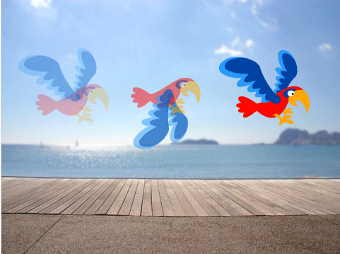
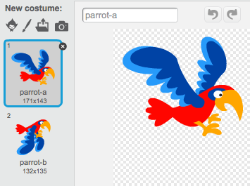
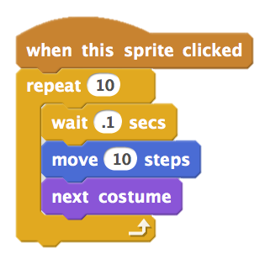
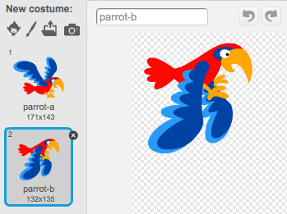
IT’S ALIVE!
HOW CAN YOU TAKE AN IMAGE OR A PHOTO AND MAKE IT COME ALIVE?
In this activity, you will explore ways of bringing sprites, images, and ideas to life as an animation by programming a series of costume changes.
START HERE
Choose a sprite.
Add a different costume.
Add blocks to make the image come alive.
Repeat!
THINGS TO TRY
FINISHED?
Try sketching your animation ideas on paper first – like a flipbook.
Experiment with different blocks and costumes until you find something you enjoy.
Need some inspiration? Find projects in the Animation section of the Explore page.
Add your project to the It’s Alive studio: http://scratch.mit.edu/studios/475529
Challenge yourself to do more! Add more features to your project to make your animations look even more lifelike.
Help a neighbor!
Share your project with a partner and walk them through your design process.
Find an animated project you’re inspired by and remix it!
Notes:
<numéro>

Slide 12

DEBUG IT!
OBJECTIVES
By completing this activity, students will:
investigate the problem and find a solution to five debugging challenges
explore a range of concepts (including sequence and loops) through the practices of testing and debugging
develop a list of strategies for debugging projects
UNIT 2 ACTIVITY
_{SUGGESTED TIME}
15–30 MINUTES
ACTIVITY DESCRIPTION
ACTIVITY DESCRIPTION
RESOURCES
Optionally, have the Unit 2 Debug It! handout available to guide students during the activity.
Help students open the Debug It! programs from the Unit 2 Debug It! studio or by following the project links listed on the Unit 2 Debug It! handout. Encourage students to click on the “Look Inside” button to investigate the buggy program, tinker with problematic code, and test possible solutions.
Give students time to test and debug each Debug It! challenge. Optionally, have students use the remix function in Scratch to fix the bugs and save corrected programs.
Ask students to reflect back on their testing and debugging experiences by responding to the reflection prompts in their design journals or in a group discussion.
Create a class list of debugging strategies by collecting students’ problem finding and problem solving approaches.
Unit 2 Debug It! handout
Unit 2 Debug It! studio
http://scratch.mit.edu/studios/475539
REFLECTION PROMPTS
What was the problem?
How did you identify the problem?
How did you fix the problem?
Did others have alternative approaches to fixing the problem?
REVIEWING STUDENT WORK
Were students able to solve all five bugs? If not, how might you clarify the concepts expressed in the unsolved programs?
What different testing and debugging strategies did students employ?
NOTES
NOTES TO SELF
Facilitate this activity in a whole group by having students act out the Debug It! programs in a similar way to the Performing Scripts activity, or introduce performing scripts as a new strategy for testing and debugging projects.
50
Notes:
<numéro>

Slide 13
DEBUG IT!
DEBUG IT! 2.1 http://scratch.mit.edu/projects/23266426
In this project, Scratch Cat wants to show you a dance. When you
click on him, he should do a dance while a drum beat plays along
with him. However, as soon as he starts to dance he stops but the
drumming continues without him! How do we fix this program?
HELP! CAN YOU DEBUG THESE FIVE SCRATCH PROGRAMS?
In this activity, you will investigate what is going awry and find a solution for each of the five Debug It! challenges.
DEBUG IT! 2.2 http://scratch.mit.edu/projects/24268476
In this project, when the green flag is clicked Pico should move
towards Nano. When Pico reaches Nano, Pico should say “Tag, you’re
it!” and Nano says “My turn!” But something is wrong! Pico doesn’t
say anything to Nano. How do we fix the program?
DEBUG IT! 2.3 http://scratch.mit.edu/projects/24268506
This project is programmed to draw a happy face but something is
not quite right! The pen continues to draw from one of the eyes to
the smile when it should not be doing so. How do we fix the
program?
START HERE
Go to the Unit 2 Debug It! Studio:
http://scratch.mit.edu/studios/475539
Test and debug each of the five debugging challenges in the studio.
Write down your solution or remix the buggy program with your solution.
DEBUG IT! 2.4 http://scratch.mit.edu/projects/23267140
In this project, when the green flag is clicked an animation of a
flower growing begins and stops once it has fully bloomed. But
something is not quite right! Instead of stopping when all the petals
have bloomed, the animation starts all over. How do we fix this
program?
FEELING STUCK?
_{THAT’S OKAY! TRY THESE THINGS…}
DEBUG IT! 2.5 http://scratch.mit.edu/projects/23267245
In this project, the Happy Birthday song starts playing when the
green flag is clicked. Once the song finishes, instructions should
appear telling us to "click on me to blow out the candles!" But
something is not working! The instructions to blow out the candles
are shown while the birthday song is playing rather than after it
finishes. How do we fix this program?
FINISHED?
Make a list of possible bugs in the program.
Keep track of your work! This can be a useful reminder of what you have already tried and point you toward what to try next.
Share and compare your problem finding and problem solving approaches with a neighbor until you find something that works for you!
Add code commentary by right clicking on blocks in your scripts. This can help others understand different parts of your program!
Discuss your testing and debugging practices with a partner – make notes of the similarities and differences in your strategies.
Help a neighbor!
Notes:
<numéro>

Slide 14

MUSIC VIDEO
OBJECTIVES
By completing this activity, students will:
be able to create a project that combines animation and music by working on a self-directed music video project
gain more familiarity with sprites, costumes, and sounds
UNIT 2 ACTIVITY
_{SUGGESTED TIME}
45–60 MINUTES
ACTIVITY DESCRIPTION
RESOURCES
Introduce students to the idea of creating a music video in Scratch that combines music with animation. Optionally, show a few project examples from the Music Video studio.
Give students open-ended time to work on their projects, with the Music Video handout available to provide guidance and inspiration. Encourage students to give credit on the project page for using others’ ideas, music, or code.
Help students give and receive feedback while developing their projects. We suggest checking in with a neighbor: have students stop midway and share their works-in-progress with one other person or in their critique groups (see the Unit 0 Critique Group activity) to ask for feedback. Optionally, invite students to add their projects to the Music Video studio or a class studio.
Ask students to think back on the design process by responding to the reflection prompts in their design journals or in a group discussion.
Music Video handout
Music Video studio
http://scratch.mit.edu/studios/475517
REFLECTION PROMPTS
What was a challenge you overcame? How did you overcome it?
What is something you still want to figure out?
How did you give credit for ideas, music, or code that you borrowed to use in your project?
REVIEWING STUDENT WORK
Did the projects combine sprites and sound?
What parts of the projects did students choose to animate?
Are there certain blocks or concepts introduced up until now that students might still be struggling with? How might you help?
NOTES
NOTES TO SELF
To further personalize projects, help students include a favorite song or record themselves singing or playing an instrument, using features under the Sounds tab.
Questions about remixing and plagiarism may arise during this activity. Take this opportunity to facilitate a discussion about giving credit and attribution using the Scratch FAQ about remixing: http://scratch.mit.edu/help/faq/#remix
52
Notes:
<numéro>

Slide 15
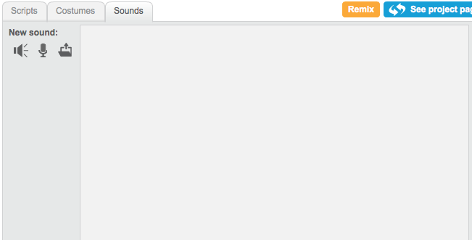
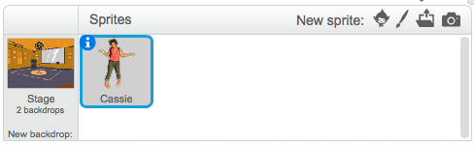
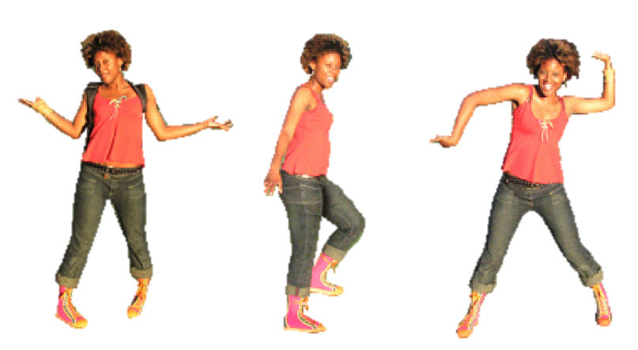
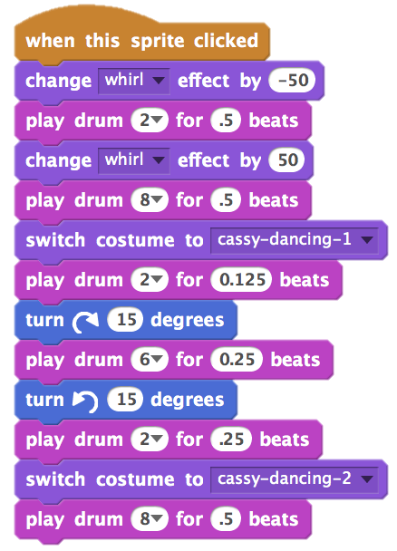
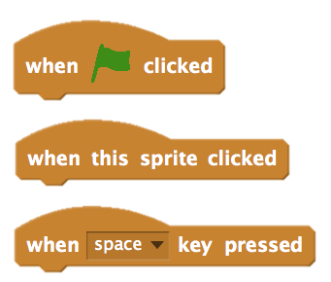
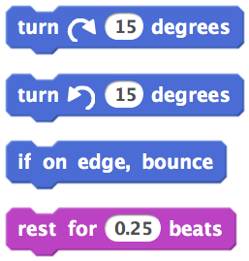
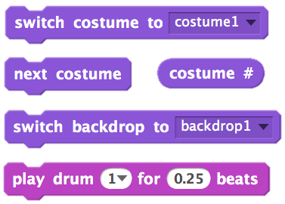
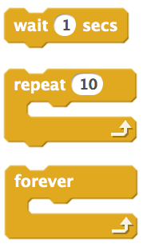
MUSIC VIDEO
HOW CAN YOU COMBINE ANIMATION WITH MUSIC TO CREATE YOUR OWN SCRATCH-INSPIRED MUSIC VIDEO?
In this project, you will explore ideas related to theatre, song, dance, music, drawing, illustration, photography, and animation to create a personalized music video!
START HERE
upload sounds from a file
Add sound.
Create and animate a sprite.
Make them interact together!
record your own sounds
choose sprite
from library
choose sounds from library
paint your own sprite
upload sprite from file
new sprite from camera
THINGS TO TRY
Use costumes to help bring your animations to life!
Make your sprite interactive by adding scripts that have the sprite respond to clicks, key presses, and more.
Add instructions on the project page to explain how people can interact with your program.
TIPS & TRICKS
FINISHED?
BLOCKS TO PLAY WITH
FINISHED?
FINISHED?
Add your project to the Music Video studio: http://scratch.mit.edu/studios/475517
Be sure to give credit to any music, code, or other work used in your project.
Challenge yourself to do more! Create your own sprites, sounds, or costumes!
Notes:
<numéro>

Slide 16
54

